Slide 1

LVM Best Practices
Efstathios Agrapidis
stathisagrapidis@gmail.com
IRC: efagra

Slide 2
What is LVM?
Linux Volume Management
Another way of partitioning the drive
higher-level view of the disk storage
Flexible partitioning schemes
Live resizing of filesystems
large installations containing many disks

Slide 3
Benefits on a Small System
How much space is going to be needed for system files and user files?
Live resizing of filesystems
Scenarios
  Shrink a filesystem – Grow another one
  Allocate minimum space – Expand acording to the live needs

Slide 4
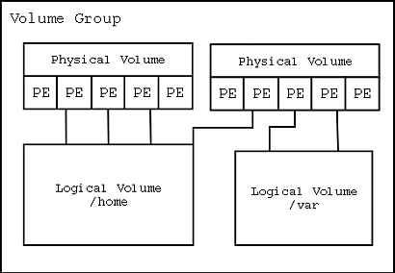
Anatomy of LVM
volume group (VG)
physical volume (PV)
logical volume (LV)
physical extent (PE)
logical extent (LE)
Snapshots

Slide 5
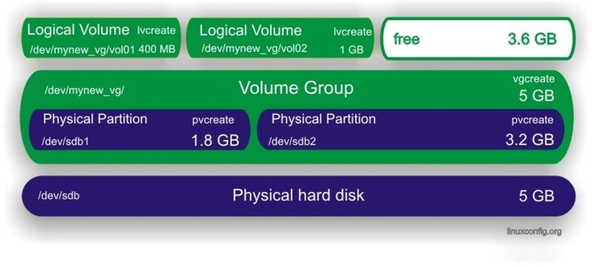
An LVM example System

Slide 6
More details
The Volume Group is the highest level abstraction used within the LVM. It gathers together a collection of Logical Volumes and Physical Volumes into one administrative unit.
A physical volume is typically a hard disk, though it may well just be a device that 'looks' like a hard disk (eg. a software raid device).
The equivalent of a disk partition in a non-LVM system. The LV is visible as a standard block device; as such the LV can contain a file system (eg. /home).
Each physical volume is divided chunks of data, known as physical extents, these extents have the same size as the logical extents for the volume group.

Slide 7
More details (continue)
Each logical volume is split into chunks of data, known as logical extents. The extent size is the same for all logical volumes in the volume group.
mapping modes (linear/striped) – The general strategies for mapping logical extents onto physical extents:
  Linear mapping will assign a range of PE's to an area of an LV in order eg., LE 1 - 99 map to PV1 and LE 100 - 347 map onto PV2.
  Striped mapping will interleave the chunks of the logical extents across a number of physical volumes.
Snapshot is an exact copy of a logical volume, frozen at some point in time. Typically this would be used when some batch processing, a backup for instance, needs to be performed on the logical volume, but you don't want to halt a live system that is changing the data.

Slide 8
Commands
pvcreate /dev/sdb1
vgcreate my_volume_group /dev/sda1 /dev/sdb1
vgchange -a y my_volume_group
vgchange -a n my_volume_group
vgremove my_volume_group
vgextend my_volume_group /dev/hdc1
pvdisplay /dev/sda1
pvmove /dev/sdb
vgreduce my_volume_group /dev/sda1

Slide 9
Commands (continue)
lvcreate -L1500 -ntestlv testvg
umount /dev/myvg/homevol
lvremove /dev/myvg/homevol
lvextend -L12G /dev/myvg/homevol
lvextend -L+1G /dev/myvg/homevol
pvmove /dev/sdb /dev/sdc
vgreduce testvg /dev/sdb

Slide 10
LVM Host System Setup

Slide 11
Multiple distro Installations Example

Slide 12
Snapshot Case
we can back up a volume without having to worry about data being changed while the backup is going on
lvcreate -L592M -s -n dbbackup /dev/testvg/databases
mkdir /mnt/ops/dbbackup
mount /dev/testvg/dbbackup /mnt/ops/dbbackup
tar -cf /pathtofile.tar /mnt/ops/dbbackup
umount /mnt/testvg/dbbackup
lvremove /dev/testvg/dbbackup

Slide 13
^{Snapshot Live Example}

Slide 14
Destruction Case Scenario

Slide 15
Recover a Raid 1 System
mdadm --manage /dev/md0 --fail /dev/sdb1
mdadm --manage /dev/md0 --remove /dev/sdb1
mdadm --manage /dev/md0 --add /dev/sdb1

